Slide 1
Automate Performance Evaluation in
Training Activities: Subsystem Demo
Group 6: Michael Simon, Jason Abdool, Zachary Astree, Yunru Liu, Jarret Dietz

Slide 2

What is our Project?
Our project consists of the design and production of a bio aware glove that measures the user’s heart rate, blood pressure, and galvanic skin responses. The measurement of this data allows for the collection in real time of any stimuli that the user experiences while carrying out tasks within an augmented reality. Using this collected data, we will be able to further analyse the user’s reactions and response times to a higher accuracy than by simply using the onboard tracking measurements by the HoloLens 2 itself.
Notes:
Hello, my name is Michael Simon. I am the team lead. Yunru Liu and Jarrett Dietz are working on the software portion of this project. Zachary Astree, Jason Abdool and myself are working on the hardware portion with Zach spending sometime working with the xAPI portion as well. The main goal of this project is build a “bio aware” glove that records the wearers health stimuli and gives a more accurate picture of how users are experiencing the simulation. In line with our sponsors vision, this glove will be an iteration of the final product which will be used in training amongst Navy soldiers.

Slide 3
What are the subsystems and roles
Haptic glove
Galvanic Sensor - Michael Simon
Measures the sweat gland activity by conductance
Heart Rate Sensor - Zachary Astree
Tracks the Heart Rate (BPM) of the user at an interval
Blood Pressure Sensor - Jason Abdool
Tracks the Blood Pressure (mmHg) of the user after interval of heart rate
Unity
Backend Connection - Jarrett Dietz, Yunru Liu, Zachary Astree
Creating a connection between hololens, sensors, and the LRS via xAPI
App engine - Jarrett Dietz, Yunru Liu
Cross platform tool used to create a 3d environment and design the application.
Hand Tracking - Jarrett Dietz, Yunru Liu
Script created in unity and VS which attaches a ball to each finger on the hand and these balls determine the x,y,z coordinates
Learning Record Store
Trax LRS - Zachary Astree
A database used to store and retrieve data that is generated from Experience API statements.
xAPI - Zachary Astree
A syntactic standard of communication from a learning software to an LRS

Slide 4
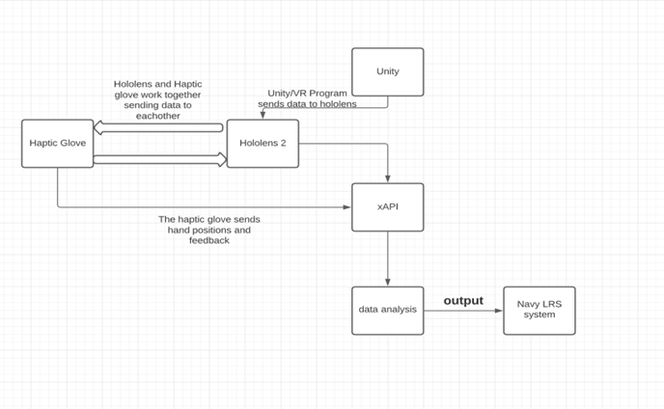
System Block Diagram

Slide 5

How to use unity to make app engine and interact with hands
We use Unity to make the app engine and build functions via MTRK. Unity allows users add different scripts so the user could be able to grab/ move objects with hands interactions in AR/VR.
We will need to add manipulator, collider, and near interaction grabbable components to the objects so that we could move the objects via Hololens 2 .

Slide 6
Particle effects
The game we are developing is a firefighter training simulation, we’ve created two particles: Fire and Water.
With these two particles, a particle collider script lets them interact with each other by disabling the fire when water hits it.
We plan to attach the water particles to a fire extinguisher which the user will then use to put out the fire.

Slide 7

Import assets and add functionality to it
We imported a fire extinguisher asset from the unity store that the last group used.
We then added functionality to it by letting user interact with it and use it in the environment.
Next we attached the particle collider script to it which will allow it to interact with the fire particles.
These are all created and used in unity MRTK.

Slide 8
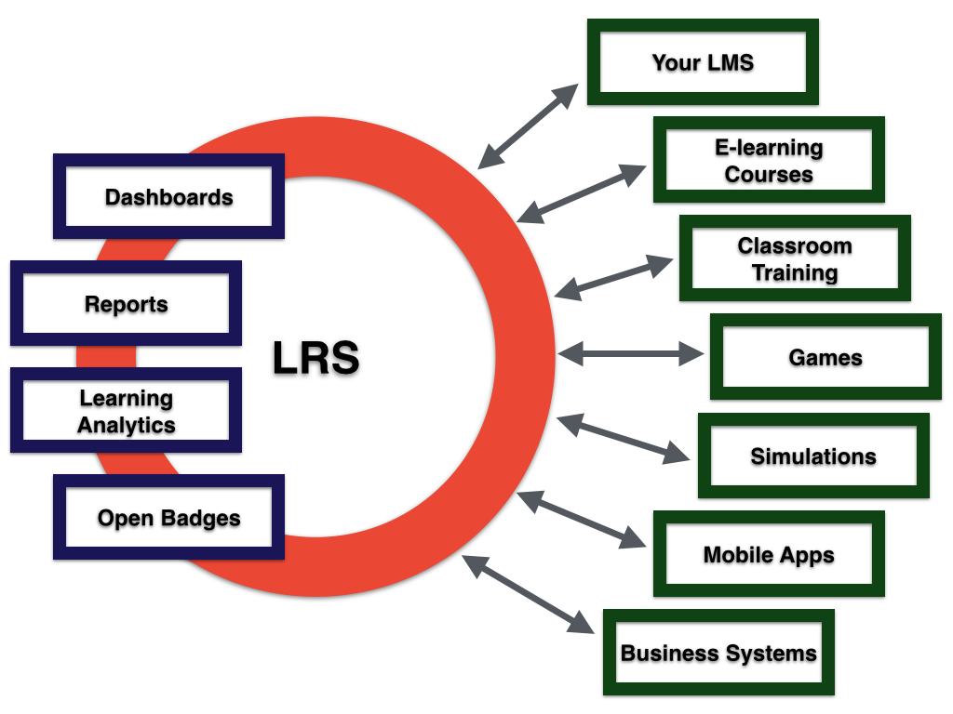
What is a Learning Record Store
Dedicated database for storing user experiences in learning applications of all kinds
Conglomerates all data and creates a graphical report of the users learning analytics
Typically has a clean UI and is very easily navigable by even adept users
Companies will usually use multiple LRS’s for certain aspects that are unique to each record store
Notes:
A learning record store is essentially a dedicated database for storing events that occurred throughout a users learning experience using a learning application. They are meant to conglomerate learning events and depict them in a easily understandable format for a website admin. Using the information stored on the LRS, developers can recommend additional training programs and areas of study to improve on the weaker aspects exhibited by a participant. They show a variety of learning analytics depending on the LRS you are using and is highly customizable by an experienced developer. Companies will typically use multiple kinds of LRS’s because each one comes with certain benefits and drawbacks depending on your use case. In most scenarios multiple kinds of LRS’s may be required.

Slide 9
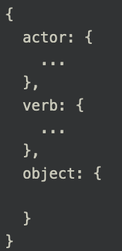
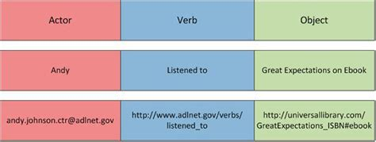
What is Experience API
xAPI is a standard of communication utilizing an Application Programming Interface
An xAPI statement must be composed of: an actor, verb, and object
Should be comprehensive and capture a variety of information for deeper learning insight
Sent in JSON format
Notes:
Experience API is typically referred to as xAPI. xAPI is basically a syntactic basis of communication utilizing an Application Programming Interface. The communication pattern requires that each statement be composed of three core components: an actor, verb, and object. The system should be comprehensive and capture information that provides a deeper understanding of the users learning patterns weaknesses and strengths. A statement is typically sent in JSON format from the Learning Management system to the LRS.

Slide 10
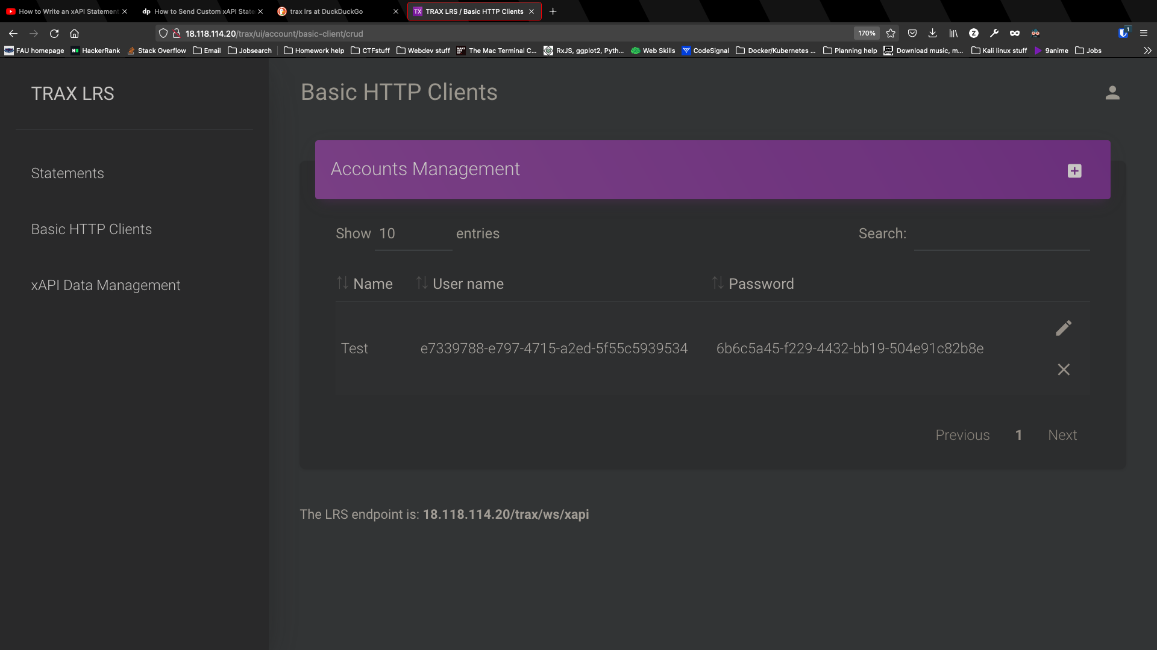
Trax LRS & XAPI
Trax is highly customizable
Utilizes the Laravel framework
Hosted using AWS
Docker ensures compatibility and consistency
Prototyping xAPI statements to ensure syntactic correctness
http://18.118.114.20
Notes:
The Trax LRS is a highly customizable LRS written using the Laravel framework. I am currently hosting the Trax LRS using an AWS Ubuntu Linux instance. To ensure compatible and consistent performance on all systems I created a docker container to encapsulate the Trax LRS. I will be creating the xAPI statements to ensure they are syntactically correct and consistent with xAPI standards. On the surface trax LRS is barebones and provides the minimum specifications required of an LRS and does not provide any built in learning analytics reporting. But due to it being built in Laravel I feel confident in my ability to add additional functionality and reporting capabilities for administrators convenience. It is also easily extensible and can be reported utilizing multiple LRS systems if need be in the future but in its current state it satisfies our basic requirements. This system can be accessed via pure SSH or the webpage depicted to the right but all in all the software is very flexible and well built in its current iteration.

Slide 11
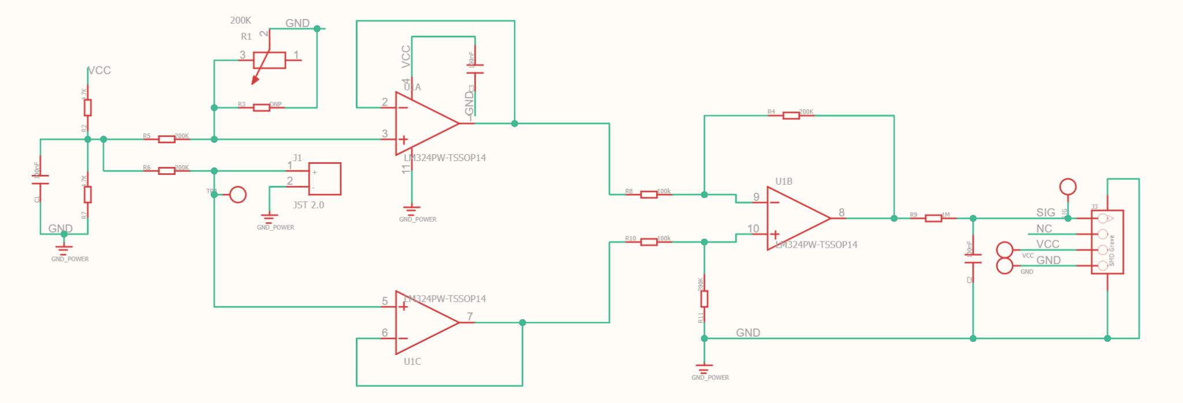
PCB and Build Schematics
Galvanic Skin Response/GSR Sensor
Notes:
Here is the schematic for the Grove GSR sensor that I will be using to record the conductivity of the user’s skin. When the wearer sweats, this sensor will measure the conductance of their skin by sending a small burst of electricity through one probe and into the other. The time that it takes for the burst to get from the first probe to the second determines the overall conductance of the wearer. By using this sensor, we are able to record a stimuli when it occurs due to the increase in sweat production when an individual is aroused.

Slide 12
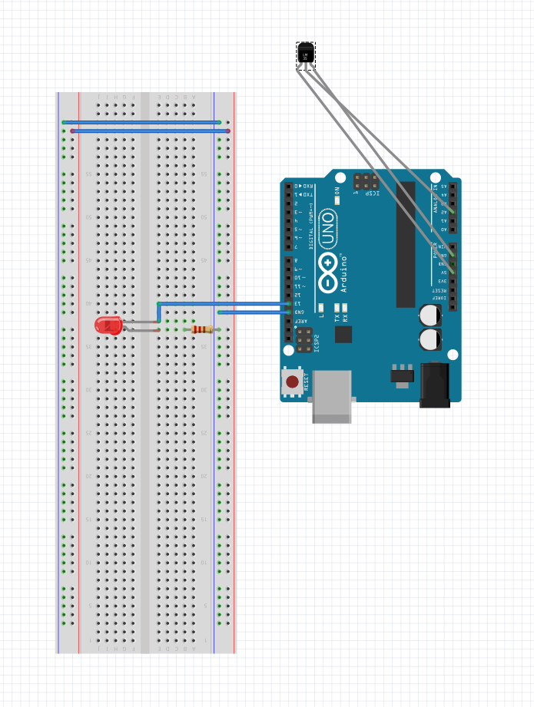
GSR Connection to Breadboard
In this photo we are demonstrating the connection of the GSR sensor to the breadboard. When the GSR sensor reads a stimuli to the average of the readings, the LED will illuminate.
Notes:
The image above depicts how the GSR sensor will be connected to the breadboard. We will have all of our sensors attached to one breadboard but for this presentation, we are displaying them all individually connected. When the user experiences and stimuli, there will be a break in the average conductance recorded and that will trigger the LED to turn on. This will allow for a visual notification if any arousal is present in the wearer.

Slide 13
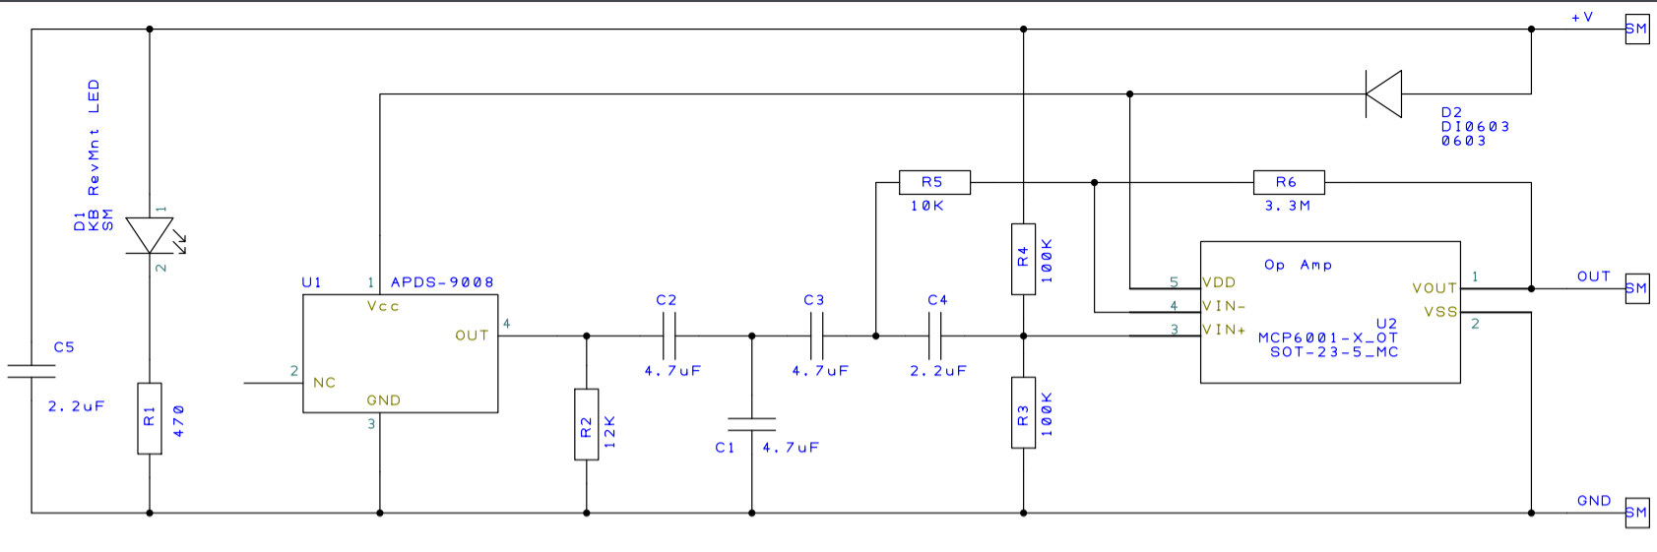
PCB and Build Schematics
Pulse Sensor/PPG

Slide 14
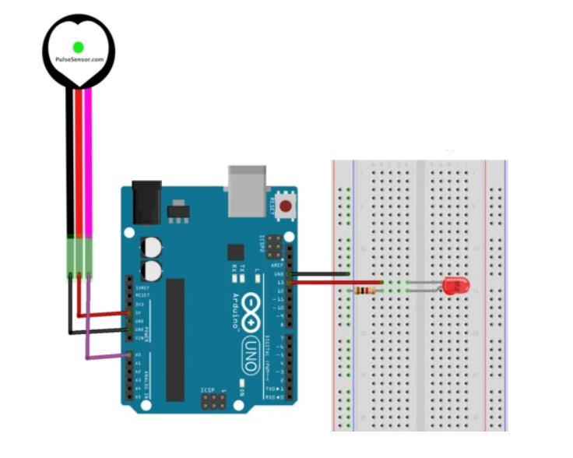
Pulse Sensor/PPG Breadboard Connection

